Slide 1
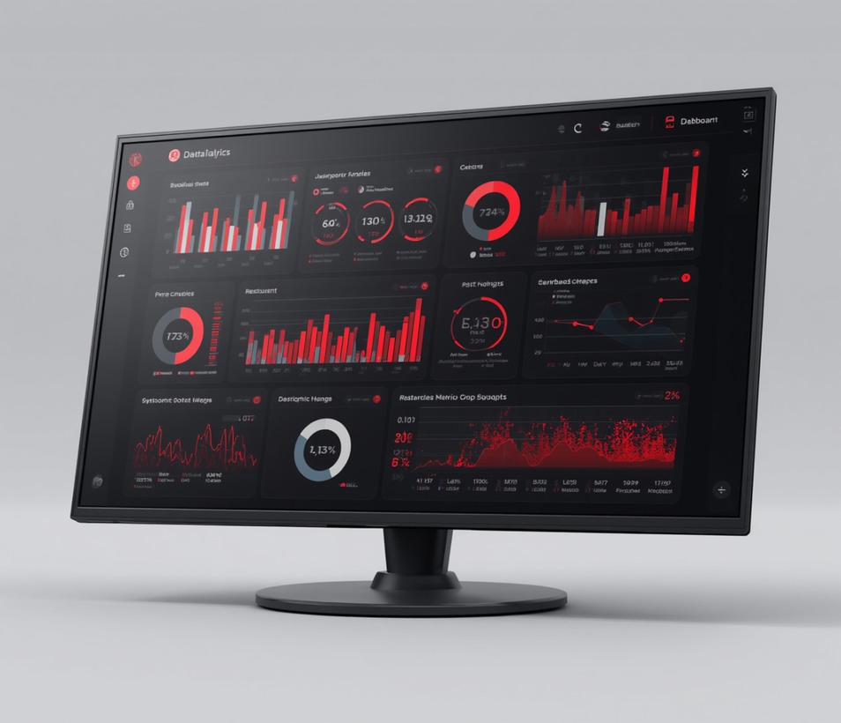
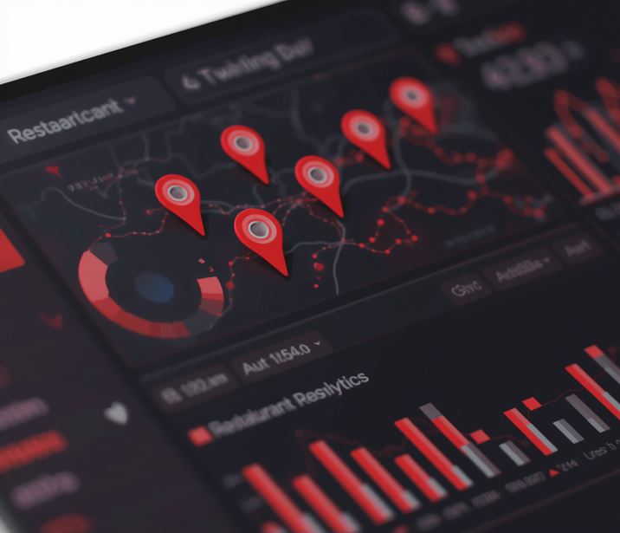
Zomato Restaurant Analytics Dashboard

Slide 2


Team Members
Rushikesh Mote
Paresh Mhalsekar
Snehal Lahankar
R. Jamuna Rani
Ved Rathore
Shaurya Gupta

Slide 3
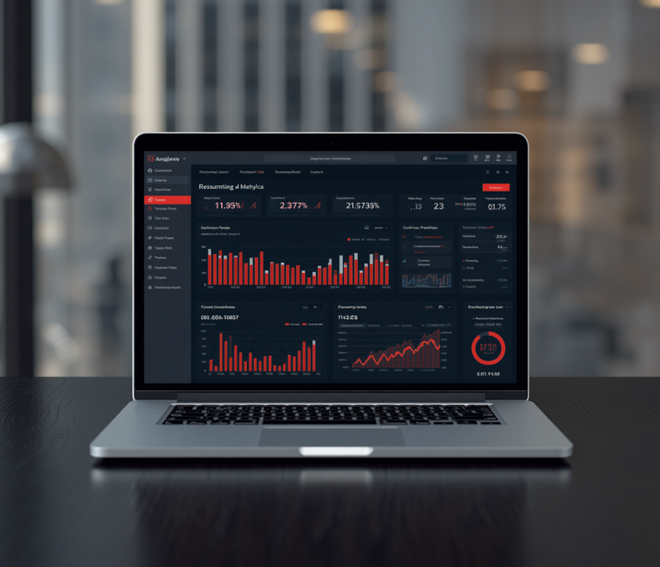
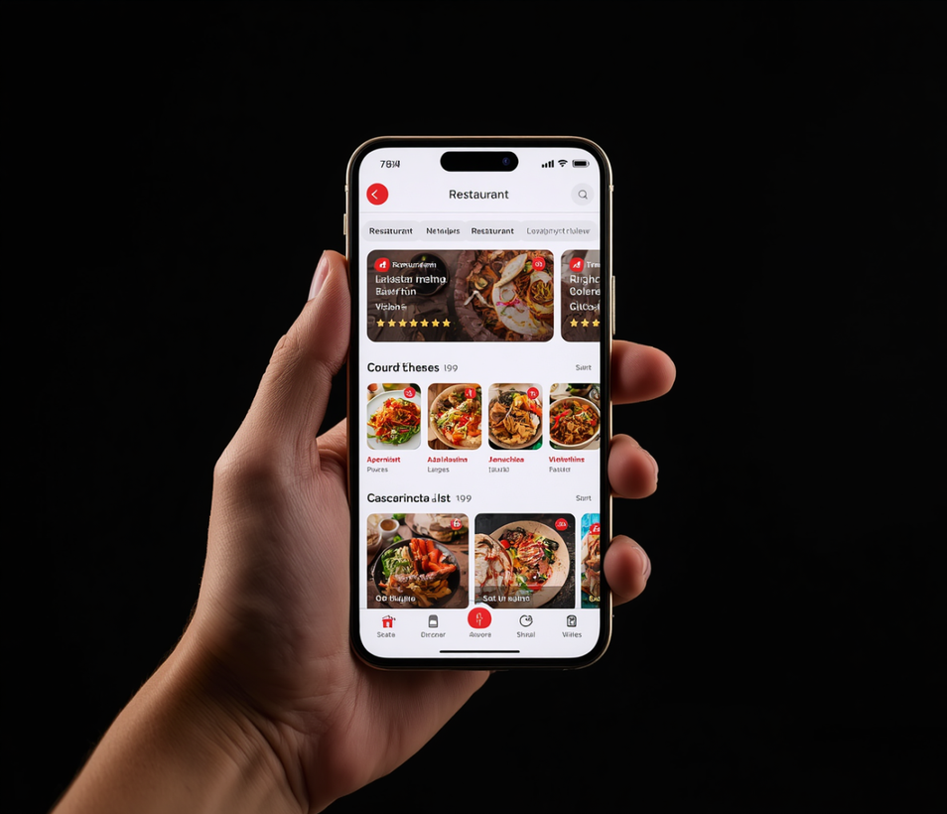
Zomato Analytics
Project Introduction
Domain: Food and Restaurant Analytics
The food delivery and restaurant industry has experienced rapid growth providing vast amounts of data related to services.
This project focuses on analyzing Zomato restaurant data to understand key business aspects such as :
Restaurant distribution across cities and countries
Customer preferences based on ratings and cuisines
Availability of services like online delivery and table booking.
By using data analytics tools, the project aims to transform raw data into meaningful insights that can help businesses improve decision-making and customer experience.

Slide 4
DATA OVERVIEW
Dataset Source: Zomato Restaurant Dataset
Dataset Type: Excel
Total Records: 9500 + Restaurants
Data Description: The dataset contains detailed information about
restaurants across multiple cities and countries, including their location, ratings, pricing, cuisines, and service features.
Important Columns:
  City & Country Code – Location details
  Cuisines – Type of food served
  Average Cost for two – Pricing Indicator
  Aggregate Rating – Customer rating (0-5 scale)
  Date Key – Used for time – based analysis

Slide 5
Project Objectives
The Zomato Restaurant Analytics Dashboard aims to deliver actionable insights from restaurant data, enabling data-driven decisions. The following core objectives guide the development and implementation of this analytics solution.
Data Cleaning & Preparation
Performance Analysis
Interactive Dashboard Design
Trend & Insight Discovery
Actionable Recommendations

Slide 6
Zomato Restaurant Analytics
Data Collection Process
The Zomato dataset was containing over 9,500 restaurant records across multiple cities. The raw CSV files include attributes such as restaurant name, location, cuisine type, average cost, ratings, votes, and online delivery status. Data was downloaded and validated for completeness before being staged for further processing.
Cleaned data was imported into SQL Server for structured querying and transformation. Excel was used for preliminary exploration and formatting. Final datasets were connected to Power BI and Tableau via direct file imports and SQL queries to build interactive analytics dashboards.

Slide 7
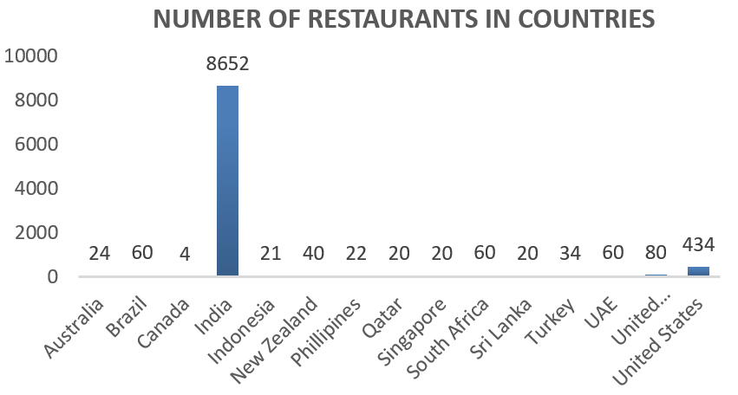
Analysis 1 – Number Of Restaurants In Countries
India has the highest number of restaurants (8,652), dominating the dataset.
The United States is second with 434 restaurants.
The United Kingdom has 80 restaurants.
Most other countries have less than 100 restaurants each.
Canada has the lowest number of restaurants (4).
The dataset is highly concentrated in India, showing Zomato's strongest presence there.
What's Included

Slide 8
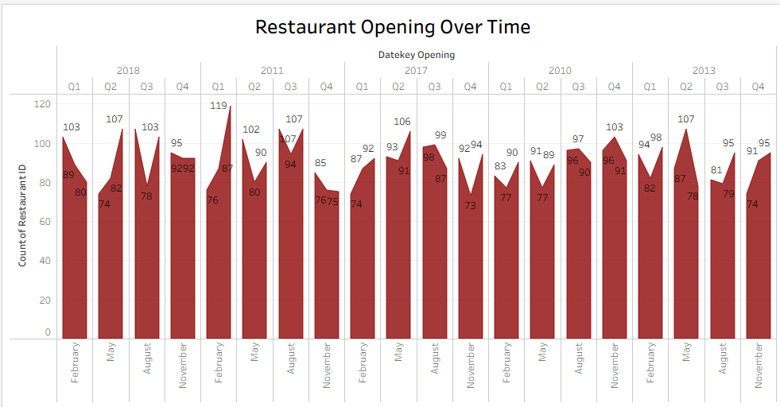
Analysis 2 – Restaurants by Year, Quarter & Month
The gradual increase of restaurants over years, indicates growth in food industry.
Quarterly analysis shows higher restaurant openings during mid & end of the year.
Monthly trends reveal fluctuations and peaks due to seasonal demand.
Overall, the data highlights a growing trend with periodic variations influenced by market conditions and demand.
What's Included

Slide 9
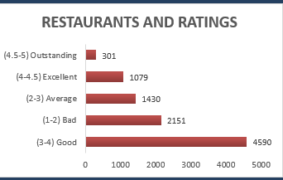
Analysis 3 – Restaurants by Rating
The majority of restaurants fall within 3.5 to 4.5 rating range
Very few restaurants have extremely (<2.5) low or perfect (5.0) ratings, showing a balanced distribution.
Higher distribution helps identify top- performing restaurants and areas needing improvement
.
What's Included

Slide 10
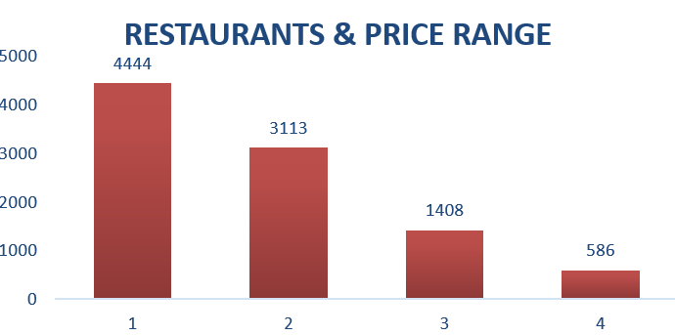
Analysis 4 – Restaurants by Price Range
Most restaurants fall within the low to mid- price range, indicating affordability is a key factor in the market.
A smaller proportion of restaurants belong to the high-price segment, targeting premium customers.
Price range analysis helps businesses understand customer spending behavior and market positioning.
.
What's Included

Slide 11
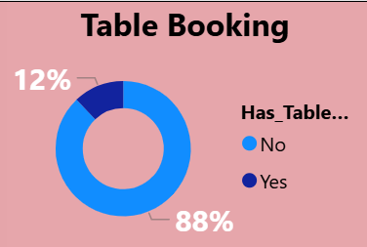
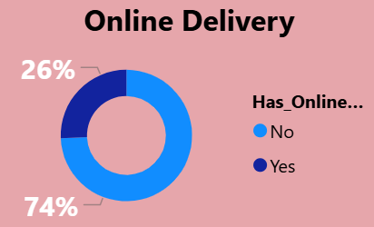
Analysis 5 – % Table Booking and Online Delivery
A higher percentage of restaurants offer online delivery, indicating strong demand for convenience and home dining.
A comparatively lower percentage provide table booking, suggesting dine-in reservations are less prioritized.
This trend highlights a shift towards digital ordering and delivery focused business models in the restaurant industry
What's Included

Slide 12
CONCLUSION
The analysis provided valuable insights into restaurant distribution, pricing, and customer preferences.
Most restaurants fall in the mid-price and mid-rating range, showing a competitive market.
Online delivery plays a major role, reflecting changing customer behavior towards convenience.
Data-driven insights can help businesses improve service quality, optimize pricing, and expand strategically.
Zomato Dataset — Source, Records & Column Overview

Slide 13
Challenges & Learnings
Challenges:
Handling missing and inconsistent data (cost, cuisines, ratings) required careful cleaning
Managing multi-value columns like cuisines and converting them into usable format
Creating accurate date formats and calendar table for time-based analysis
Writing efficient SQL queries and joins for large dataset analysis
Learnings:
Understood the importance of data cleaning as the foundation of analysis
Gained hands-on experience in SQL, Excel, Power BI, and Tableau
Learned how to convert raw data into meaningful business insights
Improved skills in data visualization and storytelling for decision-making
Zomato Dataset — Source, Records & Column Overview

Slide 14
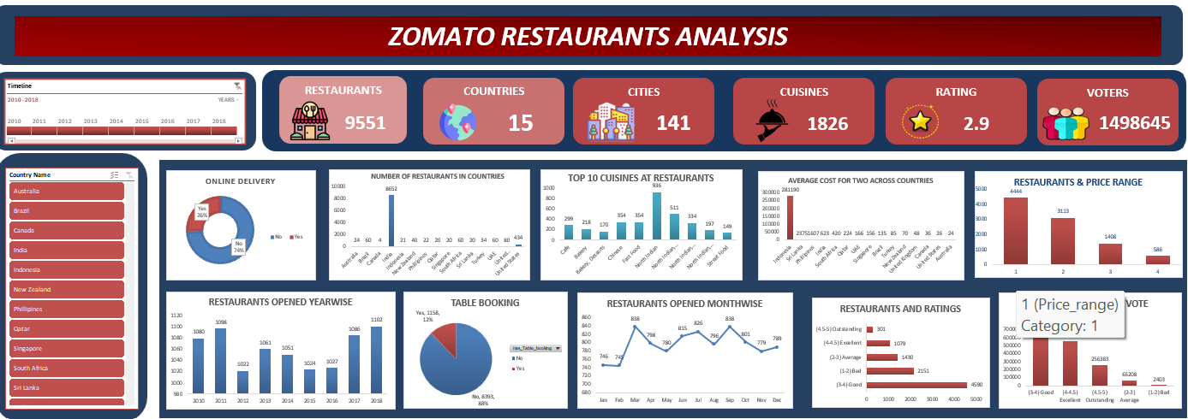
EXCEL DASHBOARD
Zomato Dataset — Source, Records & Column Overview

Slide 15
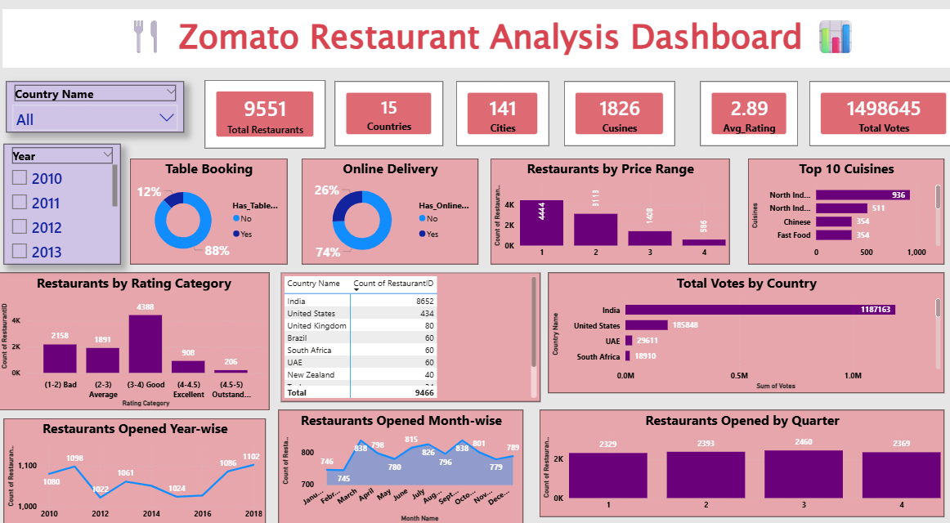
POWER BI DASHBOARD
Zomato Dataset — Source, Records & Column Overview

Slide 16
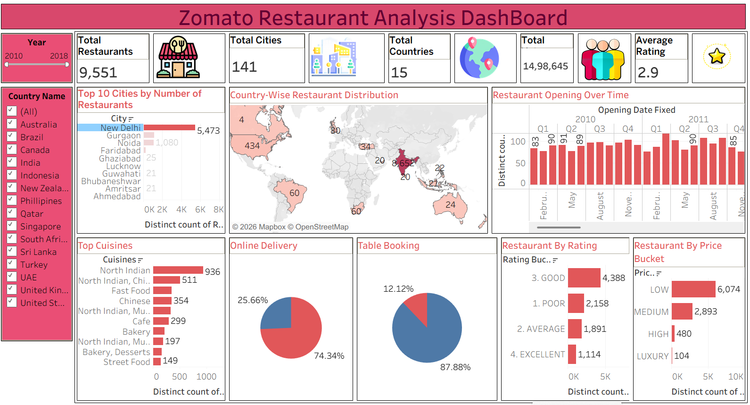
TABLEAU DASHBOARD
Zomato Dataset — Source, Records & Column Overview

Slide 17
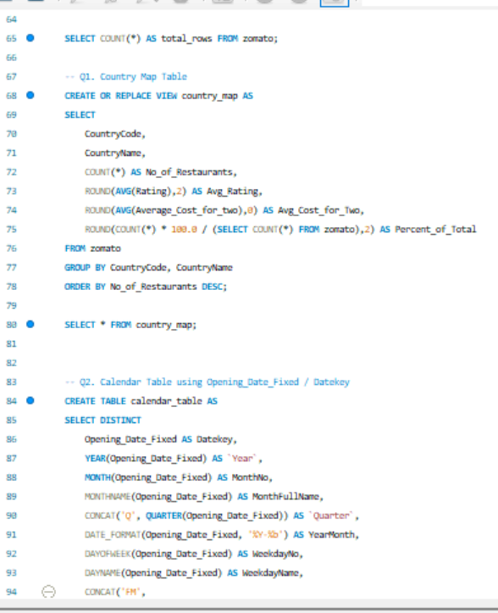
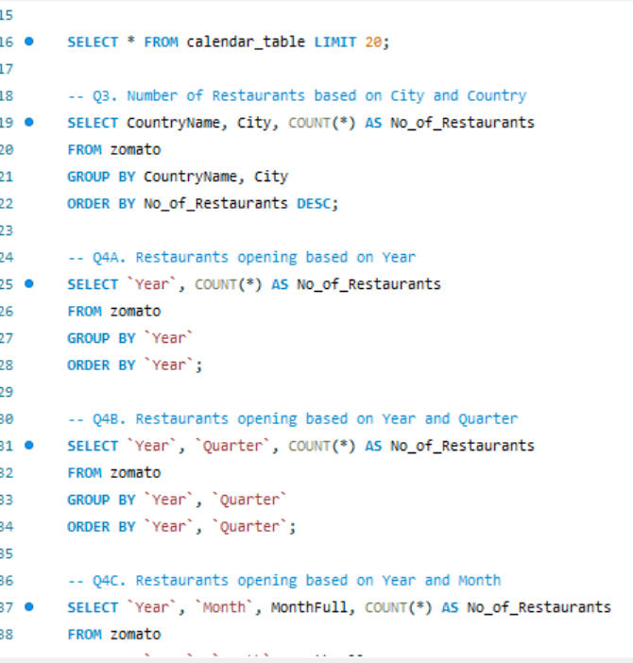
MY SQL
Zomato Dataset — Source, Records & Column Overview

Slide 18
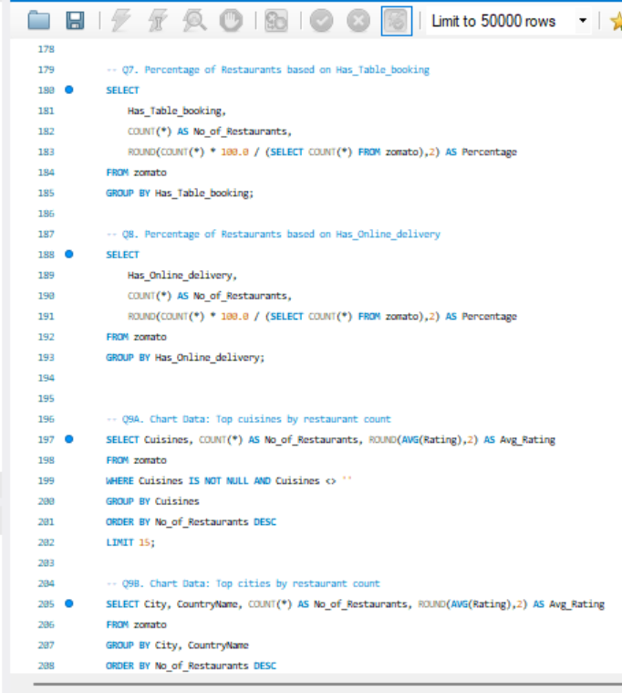
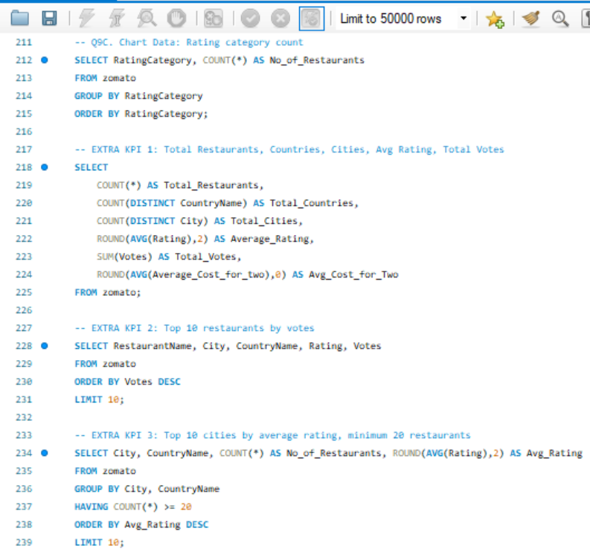
Zomato Dataset — Source, Records & Column Overview

Slide 19
















Future Enhancements
The Zomato Restaurant Analytics Dashboard has significant potential for growth and expansion. The following enhancements are planned to elevate the platform's capabilities, deliver deeper insights, and provide a more seamless, intelligent, and scalable analytics experience for stakeholders and restaurant partners.
Real-Time Data Streaming
ML Predictive Analytics
Mobile App Integration
Expanded KPI Metrics
Live API Connections

Slide 20
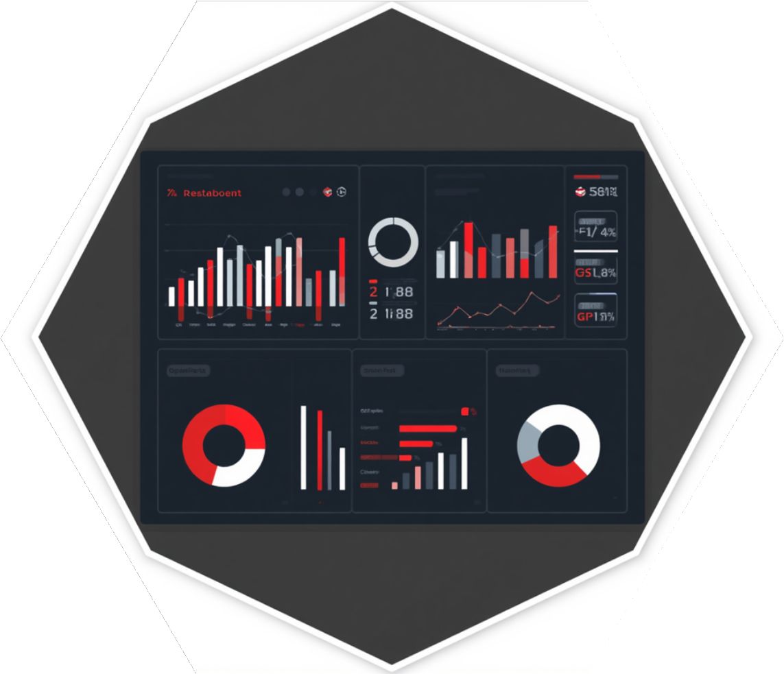
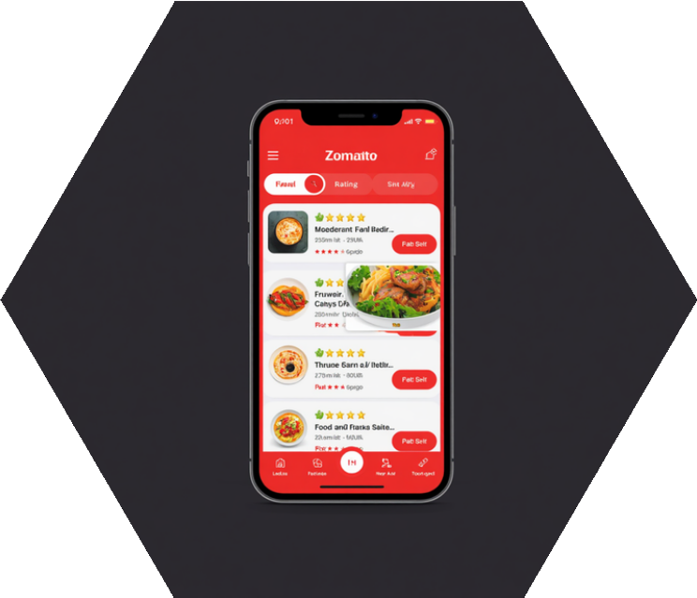
THANK YOU

